Slide 1

Comprehensive PHP Workshop: Building Websites and Web Applications
PHP Unleashed: Quick Hands-On for Smart Coding!

Slide 2

Project analysis slide 6
quick
chat with
audience

Slide 3
Project analysis slide 6
Objective
My Insights and Considerations
Understanding the fundamentals of PHP for web development
Emphasizing best practices in coding standards
Ensuring participants can create simple forms and establish database connectivity

Slide 4
Project analysis slide 6
Agenda
Session-1: Assessing Audience Requirements
Quick chat with Students
Building a Simple HTML Website

Slide 5
Project analysis slide 6
Session-1
Let’s begin with simple HTML web pages
Create following html pages:
home.html
about.html
product.html
services.html
contact_us.html

Slide 6
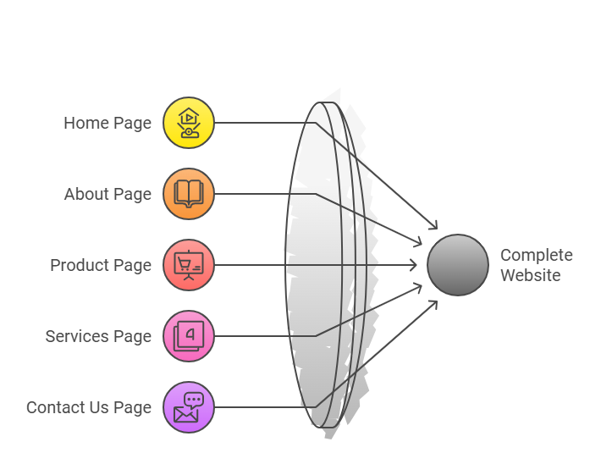
Project analysis slide 6
Session-1
Let’s begin with simple HTML web pages
Requirements
Create navigation with each page by creating hyperlink between all the pages.
Display simple message in all the pages.

Slide 7
Project analysis slide 6
Session-1
Let’s begin with simple HTML web pages
Home page
Home
About Us
Products
Services
Contact Us
Home Page…….

Slide 8
Project analysis slide 6
Session-1
Let’s begin with simple HTML web pages
About us page
Home
About Us
Products
Services
Contact Us
About Us Page…….

Slide 9

How much time is required to develop simple web pages?
Home page
Home
About Us
Products
Services
Contact Us
Home Page…….

Slide 10
How much time is required to develop simple web pages?
Home page
Home
About Us
Products
Services
Contact Us
Approx
10 mins ?
Home Page…….

Slide 11
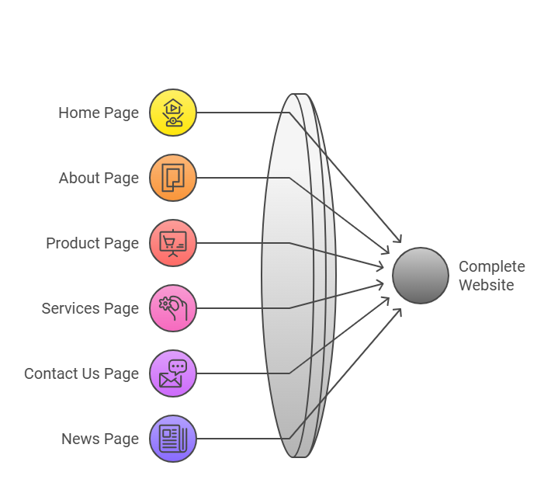
Project analysis slide 6
Session-1
Let’s begin with simple HTML web pages
New Requirement:
- Add news.html page in website, make proper navigation between all the pages.
Home
About Us
Products
Services
Contact Us
News
News Page…….

Slide 12
Project analysis slide 6
Agenda
Session-2: Getting start with PHP
PHP Coding Standards
Building a Simple HTML Website using PHP

Slide 13
Project analysis slide 8
PHP Coding Standards
Naming Conventions
Use meaningful and descriptive names for variables, functions, and classes
PHP conventions often prefer snake_case for variable and function names and PascalCase for class names
Bad Naming
$a = “John”; //Ambiguous variable
function foo($x, $y){
return $x + $y;
}
class abc{
public $name;
public $email;
}

Slide 14
Project analysis slide 8
PHP Coding Standards
Naming Conventions
Use meaningful and descriptive names for variables, functions, and classes
PHP conventions often prefer snake_case for variable and function names and PascalCase for class names
Bad Naming
Good Naming
$a = “John”; //Ambiguous variable
function foo($x, $y){
return $x + $y;
}
class abc{
public $name;
public $email;
}
$customer_name = “John”; //Descriptive variable

Slide 15
Project analysis slide 8
PHP Coding Standards
Naming Conventions
Use meaningful and descriptive names for variables, functions, and classes
PHP conventions often prefer snake_case for variable and function names and PascalCase for class names
Bad Naming
Good Naming
$a = “John”; //Ambiguous variable
function foo($x, $y){
return $x + $y;
}
class abc{
public $name;
public $email;
}
$customer_name = “John”; //Descriptive variable
function sum_of_two_num($num_1, $num_2){
return $num_1 + $num_2;
}

Slide 16
Project analysis slide 8
PHP Coding Standards
Naming Conventions
Use meaningful and descriptive names for variables, functions, and classes
PHP conventions often prefer snake_case for variable and function names and PascalCase for class names
Bad Naming
Good Naming
$a = “John”; //Ambiguous variable
function foo($x, $y){
return $x + $y;
}
class abc{
public $name;
public $email;
}
$customer_name = “John”; //Descriptive variable
function sum_of_two_num($num_1, $num_2){
return $num_1 + $num_2;
}
class CustomerDetails{
public $name;
public $email;
}

Slide 17
Project analysis slide 8
PHP Coding Standards
Formatting and Indentation
Use consistent indentation (e.g., 4 spaces).
Ensure braces and parentheses are consistently styled.
Limit line length to 80–120 characters.
Bad Formatting
Good Formatting
$is_logged_in = false;
If($is_logged_in){echo “Welcome back!”;}
else{echo “Please log in.”;}
$is_logged_in = false;
If($is_logged_in){
echo “welcome back!”;
}else {
echo “Please log in.”;
}

Slide 18
Project analysis slide 8
PHP Coding Standards
Comments and Documentation
Use comments to explain the purpose of code but avoid unnecessary comments.
Without Comment
function sum_of_two_num($num_1, $num_2){
return $num_1 + $num_2;
}

Slide 19
Project analysis slide 8
PHP Coding Standards
Comments and Documentation
Use comments to explain the purpose of code but avoid unnecessary comments.
Without Comment
With Comment
function sum_of_two_num($num_1, $num_2){
return $num_1 + $num_2;
}
# METHOD : Name of functions
# DESCRIPTION : Description of functions.
# PARAMETERS:
# num_1: Numeric variable 1
# num_2: Numeric variable 2
# RETURN VALUES:
# numeric: sum of two numeric variables

Slide 20
Project analysis slide 8
PHP Coding Standards
Comments and Documentation
Use comments to explain the purpose of code but avoid unnecessary comments.
Without Comment
With Comment
function sum_of_two_num($num_1, $num_2){
return $num_1 + $num_2;
}
# METHOD : Name of functions
# DESCRIPTION : Description of functions.
# PARAMETERS:
# num_1: Numeric variable 1
# num_2: Numeric variable 2
# RETURN VALUES:
# numeric: sum of two numeric variables
function sum_of_two_num($num_1, $num_2){
return $num_1 + $num_2;
}

Slide 21
Project analysis slide 8
PHP Coding Standards
DRY Principle (Don’t Repeat Yourself)
Avoid repeating similar values/code in entire file.
Without DRY approach
if ($degree == ‘MCA’){
echo “Master of Computer Application”;
}
echo “MCA”;
if(strlen(‘MCA’) == 3)){
echo “Degree with 3 letters”;
}

Slide 22
Project analysis slide 8
PHP Coding Standards
DRY Principle (Don’t Repeat Yourself)
Avoid repeating similar values/code in entire file.
Without DRY approach
With DRY approach
if ($degree == ‘MCA’){
echo “Master of Computer Application”;
}
echo “MCA”;
if(strlen(‘MCA’) == 3)){
echo “Degree with 3 letters”;
}
$mca_label = ‘MCA’
if ($degree == $mca_label){
echo “Master of Computer Application”;
}
echo $mca_label;
if(strlen($mca_label) == 3)){
echo “Degree with 3 letters”;
}

Slide 23
Project analysis slide 8
PHP Coding Standards
Code Reusability
Create functions/module to increase the reusability of code
Not Reuse of code
Reuse of code
$num1 = 10;
$num2 = 20;
echo $num1 + $num2;
//adding of other pair
$n1 = 13;
$n2 = 15;
echo $n1 + $n2;
function add_two_num($num_1, $num_2)
{
return $num_1 + $num_2;
}
//calling the function
echo add_two_num(10,20);
echo add_two_num(13,15);

Slide 24
Project analysis slide 8
PHP Coding Standards
Avoid Mixing Logic and HTML
Separate the PHP logic from the HTML structure as much as possible to keep code clean and easy to maintain.
Bad Practice (Mixed)
<html>
<body>
<?php
$message = “Hello”;
echo $message;
?>
</body>
</html>

Slide 25
Project analysis slide 8
PHP Coding Standards
Avoid Mixing Logic and HTML
Separate the PHP logic from the HTML structure as much as possible to keep code clean and easy to maintain.
Bad Practice (Mixed)
Good Practice (Separated)
<html>
<body>
<?php
$message = “Hello”;
echo $message;
?>
</body>
</html>
<?php
$message = “Hello”;
?>
<html>
<body>
<p><?php echo $message; ?></p>
</body>
</html>

Slide 26
Project analysis slide 8
PHP Coding Standards
Constants for Fixed Values
Define constants for values that do not change, such as database credentials or application settings.
Bad Practice
Good Practice (Define Constant)
$site_name = “My Website”;
echo “Welcome to” . $site_name;
define("SITE_NAME", "My Website");
echo "Welcome to " . SITE_NAME;

Slide 27
Project analysis slide 6
Converting HTML Website to PHP
Step 1:
Change extension to .php
Update the navigation hyperlink with PHP files.

Slide 28
Project analysis slide 6
Converting HTML Website to PHP
Step 2: Make use of PHP programming language to build dynamic pages to improve productivity and re-usability.
Create template of web pages
<header>
<body>
<footer>
Create a header.php and footer.php
Include the file header and footer in webpages
Dynamic website is ready!

Slide 29
Project analysis slide 6
Some PHP programming concept
How to write PHP code
opening tag <?php
PHP code/statements
closing tag ?>
Single line expression:
<?= expression ;>

Slide 30
Project analysis slide 6
Some PHP programming concept
Print Functions :
echo : to display the value.
print : to display the value.
print_r : print the value of array.
var_dump() : dump information about variable.

Slide 31
Project analysis slide 6
Some PHP programming concept
Create Variable:
$variable_name = value;
Create function:
function function_name(parameters):return type{
return value;
}

Slide 32
Project analysis slide 6
Some PHP programming concept
Arrays
Indexed array:
$company = array(“Apple”, “IBM”, “Google”);
Associative array:
$apple = array(“product” => ”iphone”,
“model” => ”16 pro”,
“year” => 2024);

Slide 33
Project analysis slide 6
Some PHP programming concept
foreach loop: to iterate the element of array
$company = array(“Apple”, “IBM”, “Google”);
foreach($company as $item)
{
echo $item;
}

Slide 34
Project analysis slide 6
Some PHP programming concept
Retrieve HTML Forms data
Two ways:
$_GET -> through query string.
$_POST -> through HTML form.
Syntax:
$_GET[‘name-of-element’]
$_POST[‘name-of-element’]

Slide 35
Project analysis slide 6
Some PHP programming concept
Session is a mechanism for storing information in variables that can be accessed across multiple web pages for a specific period.
$_SESSION[‘variable-name’]
<?php
# start session
session_start();
# Add details into the session
$_SESSION[‘user’] = “Ankit”;
# Access session variable
echo $_SESSION[‘user’];
?>

Slide 36
Project analysis slide 6
Some PHP programming concept
Session is a mechanism for storing information in variables that can be accessed across multiple web pages for a specific period.
$_SESSION[‘variable-name’]
<?php
# start session
session_start();
# Add details into the session
$_SESSION[‘user’] = “Ankit”;
# Access session variable
echo $_SESSION[‘user’];
?>
<?php
session_start();
#Remove all session variables session_unset();
#Destroy the session
session_destroy();
?>

Slide 37
Thank You

